Slide 1

Applications and Types of Machine Learning

Slide 2
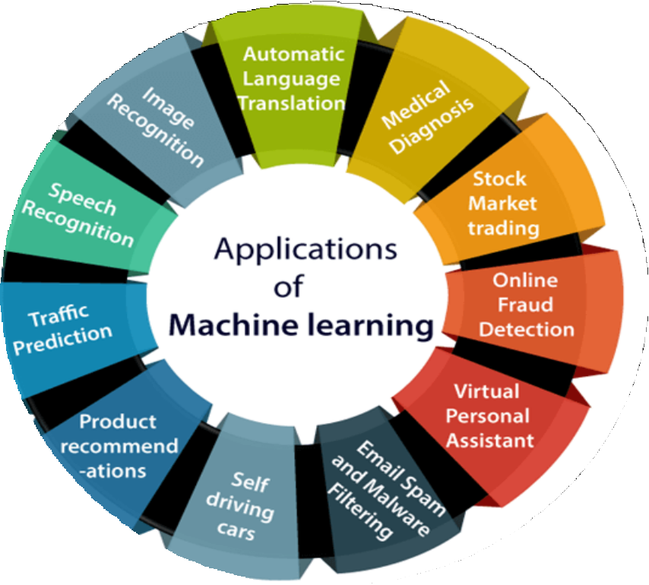
Application Areas

Slide 3
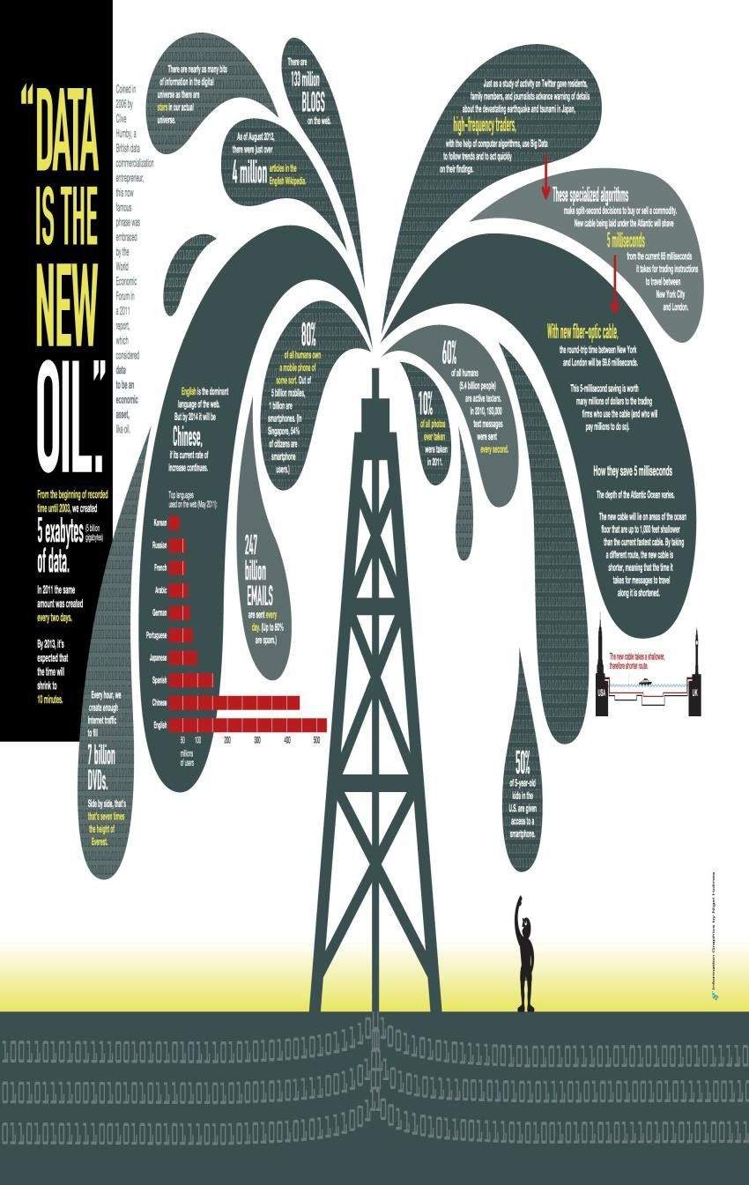
Why Machine Learning hype?
Data is the new Oil!!!
Enough Data but Scarce Knowledge
1 trillion web pages – Web mining
One hour of video is uploaded to YouTube
every second amounting to 10 years of content every day
1M transactions per hour in Walmart
Science – Bioinformatics, Astrophysics... Genomes 1000s of people, each of which has a length of 3.8 × 109 base pairs sequenced by various labs;

Slide 4
Why Machine Learning is inevitable ?
Intellectually rich due to Mathematics and Algorithms
Human design has limitations
NLP, Computation, handwriting recognition
Dynamic Environment
Autonomous helicopter, self driving car
New knowledge evolved and redesign is difficult
Self customizing programs
Amazon product recommender system.
DATA DOES THE TRICK !!!

Slide 5
Machine Learning Applications
Applications Stakeholders
Doctors
Netflix, Amazon
Social media like Facebook
Web service providers
Google assistant, Amazon Alexa
Tesla
Financiers
Disease Diagnostics
Recommendation
Image Tagging
Advertising
Speech Processing
Self-driving car
Share Trading

Slide 6
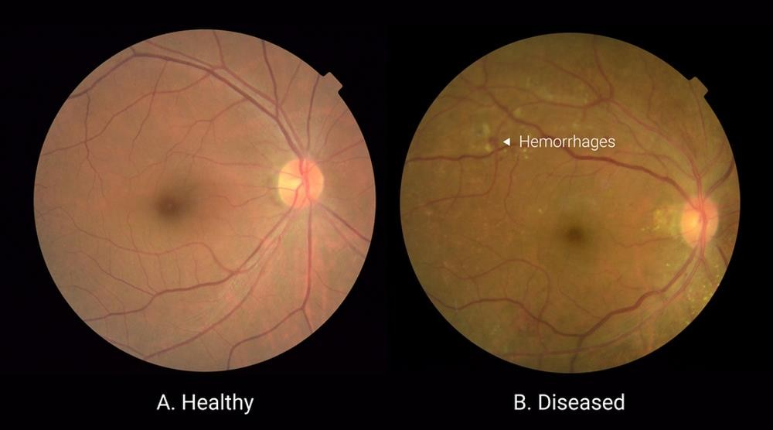
Disease Diagnostics (Computer Vision)
Diagnose Diabetic Retinopathy
Source : https://blog.google/technology/ai/detecting-diabetic-eye-disease-machine-learning/

Slide 7
T, E, P for Diabetic Retinopathy
Task : Specific work
Diagnose if the patient has Diabetic Retinopathy or not (Classification)
Experience : Data available
Eye images of various DR/non-DR patients
Performance : Accurately perform work Correctly diagnosed DR patients

Slide 8
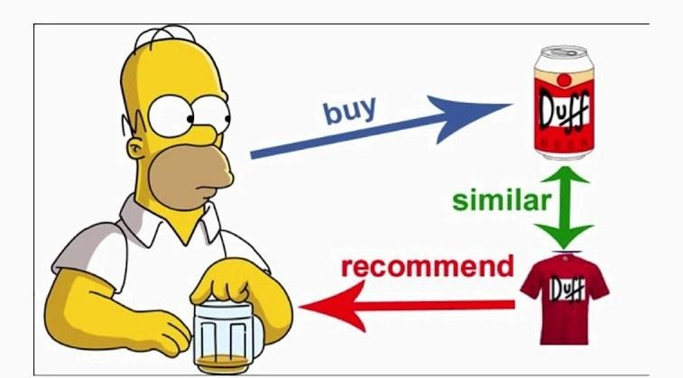
Recommendation Systems

Slide 9
Share Trading
T, E, P for Share Trading
Task : Specific work
What will be the share price of HDFC after a week (Regression)
Experience : Data available
For each date, the opening price, closing, high, low buying etc. since 5 years
Performance : Accurately perform work
How closer was the predicted price to the actual price.

Slide 10
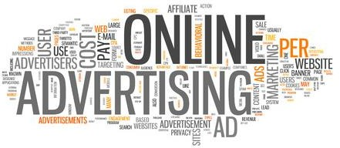
Online Advertising

Slide 11
References
https://towardsdatascience.com/build-your-own-recommender-system-within-5-
minutes-30dd40388fbf
https://blog.google/technology/ai/detecting-diabetic-eye-disease-machine- learning/
https://in.pinterest.com/pin/345369865144445661/
https://www.livemint.com/money/personal-finance/paytm-to-start-share- trading-services-soon-11578294511902.html
https://www.adspeed.com/Blog/Five-most-common-online-advertising-mistakes- 1692.html
https://www.javatpoint.com/applications-of-machine-learning

Slide 12
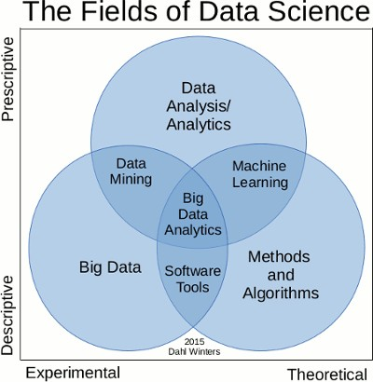

Slide 13
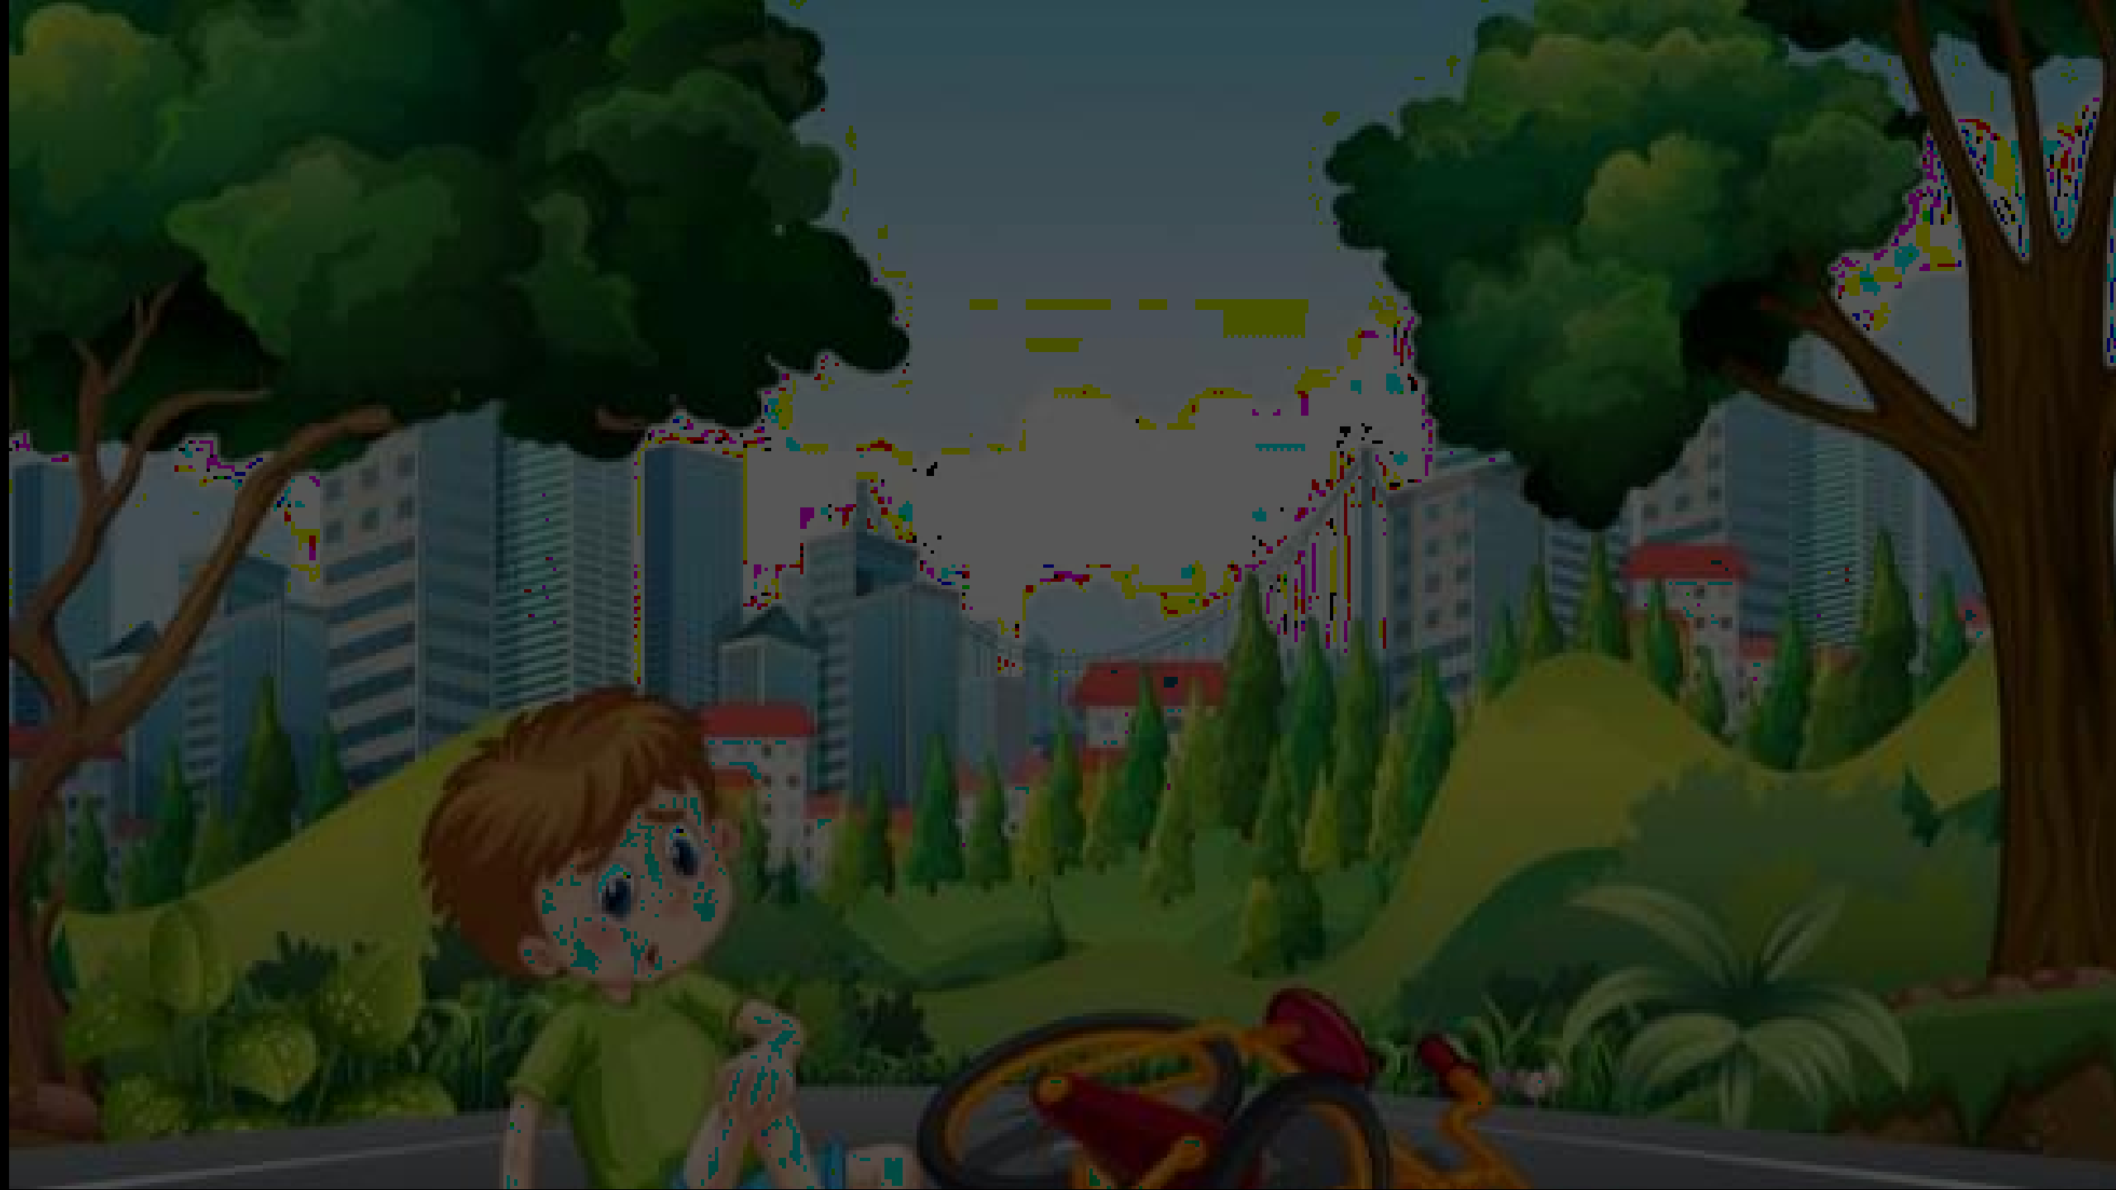









Types of Machine Learning
•

Slide 14
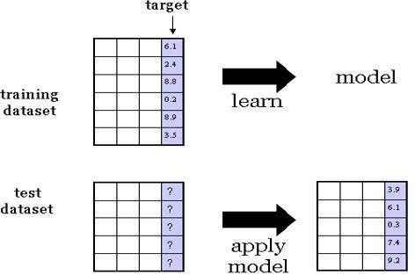
Supervised Learning from Data
Predicting continuous target variable

Slide 15

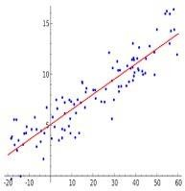
Task : Regression
Example : Stock Price Prediction
Only one target variable ?
How to take a combination of the features (linear regression)?
Anything more general than that?
Is local minimum error the global minimum error ?

Slide 16
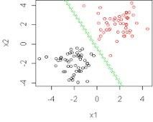
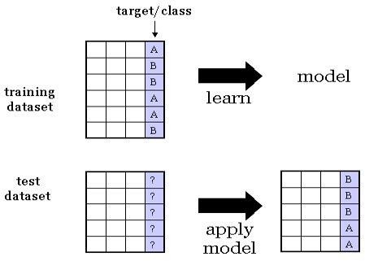
Task : Classification
Example : Classify whether the patient is suffering from cancer or not.

Slide 17
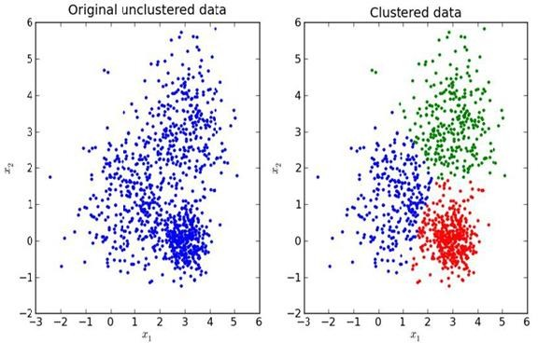
Unsupervised Learning
Task : Clustering
No Target variable

Slide 18
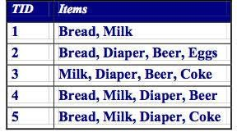
Task : Association mining
{milk} → {bread}
{milk, cheese, eggs} → {bread}
{milk, diaper} → {beer}

Slide 19
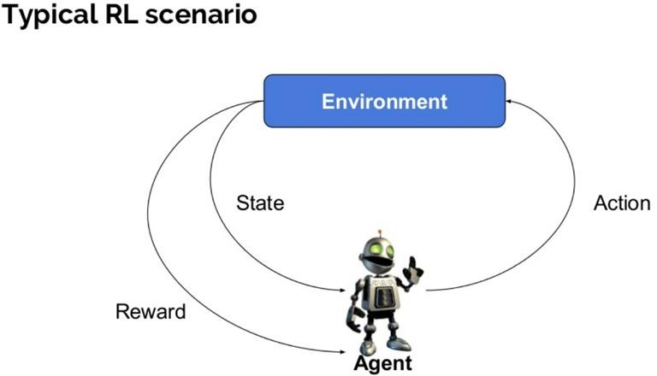
Reinforcement Learning
Learn from interaction with the environment
Transition from one state to another
Rewards/punishments from sequence of actions
Game Playing Robotics
Image Source : https://www.guru99.com/reinforcement-learning-tutorial.html

Slide 20
Applications
Manufacturing
Pick a device and put it in right container
Self-driving cars
Detect obstacles, proper routing, traffic signal
Power systems
Network routing

Slide 21
References
https://chatbotsmagazine.com/reinforcement-learning-and-its- practical-applications-8499e60cf751
https://www.guru99.com/reinforcement-learning-tutorial.html
https://cs.gmu.edu/~jessica/DimReducDanger.html
https://elearningindustry.com/machine-learning-process-and- scenarios

